Slide 1
Alibaba Ecommerce Company
Presented by: Dipesh Tha Shrestha
Presented To: Kushal Regmi

Slide 2
Introduction
Alibaba.com is a Chinese multinational technology company specializing in e-commerce, retail, Internet, and technology.
Founded on 28 June 1999, in Hangzhou, Zhejiang.

Slide 3
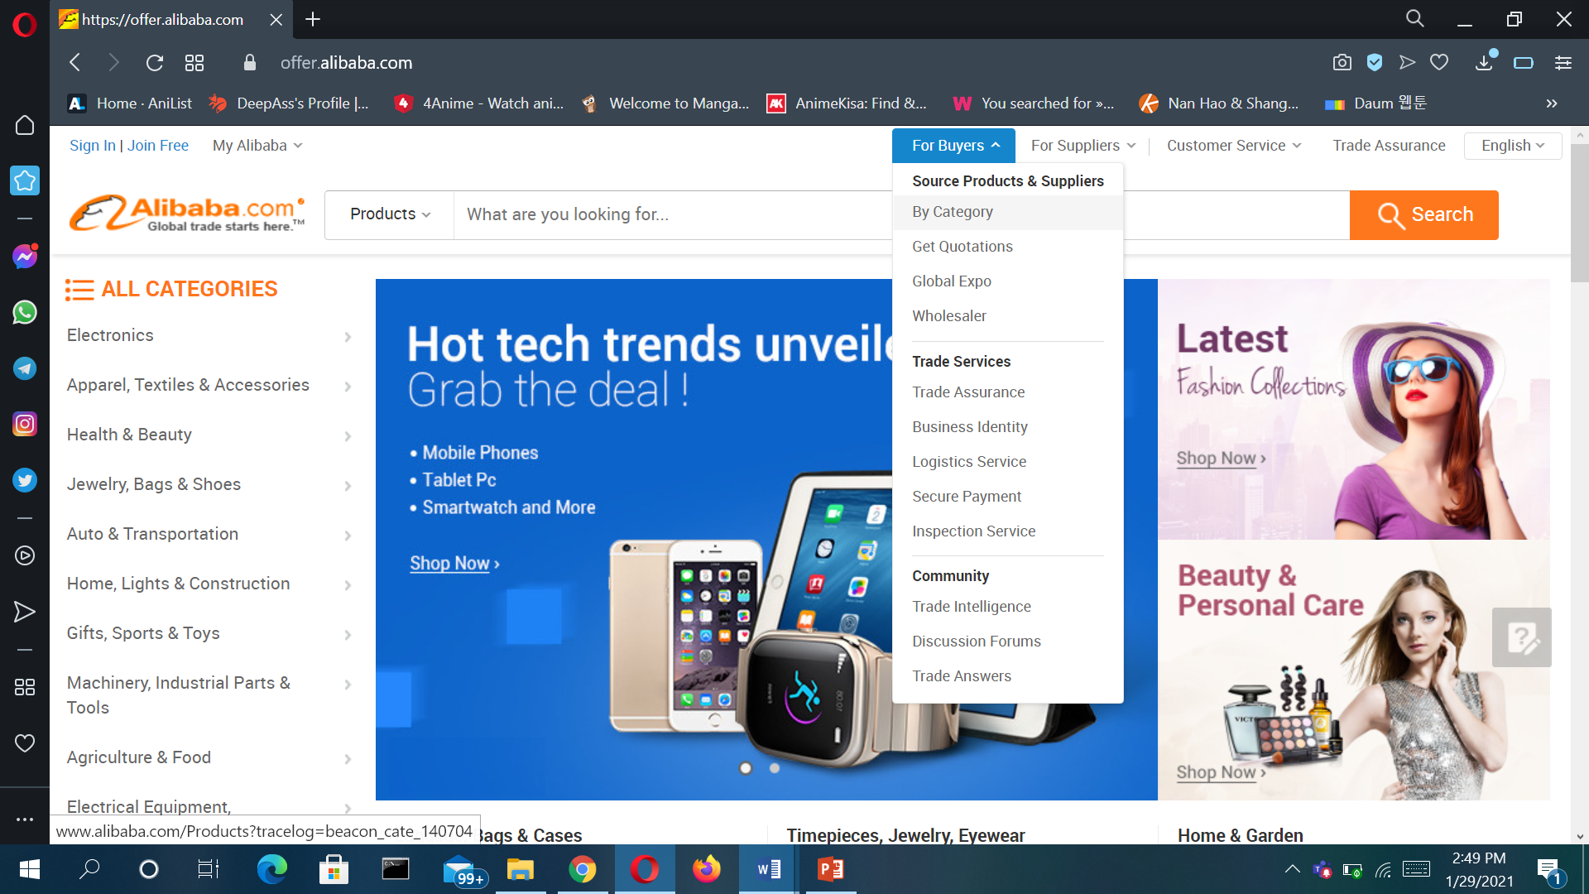
Official site of Alibaba

Slide 4
Features
Internal re-marketing
live stream shopping
Attracting Sellers by Eliminating listing fees
Multi language sites

Slide 5
Types of e-commerce that have been used in Alibaba
B2B
Merchants pay annual sellers' fees and sales commissions to Alibaba. They can list a limited number of products for free but have the option to pay for a range of benefits such as greater exposure on the site and unlimited product listings.

Slide 6
Types of e-commerce have been used
2. C2C
Taobao doesn't charge transaction fees and the site is free for merchants to join, a policy that helped the site gain its enormous user base in China. Its main revenue source is advertising fees paid by merchants who want to stand out from the literally millions of competitors on the site.

Slide 7
Types of e-commerce have been used
3. B2C
Tmall is the part of Alibaba that most resembles eBay and Amazon, which also collect transaction fees from third-party merchants.

Slide 8
Business models being used in Alibaba
The company provides consumer-to-consumer (C2C), business-to-consumer (B2C), and business-to-business (B2B) sales services via web portals, as well as electronic payment services, shopping search engines and cloud computing services.

Slide 9
Advantages of Buying from Alibaba:
Ability to design your own custom-made products
Ability to buy bulk wholesale products directly from manufacturers
Affordable prices
Increased control over product packaging

Slide 10
Disadvantages of Buying from Alibaba:
Higher upfront cost
Reality of products may differ from display images on website
Maximum order amount needed for discounted pricing

Slide 11
Strategy Alibaba can take to provide better services
Site speed
Use High-Quality Photographs and Good Product Descriptions
Improve Your Social Media Strategy

Slide 12
New technologies company has implemented
Alibaba use global tracking system. It uses Internet of Things (IoT) and blockchain technology to verify products purchased by consumers through dual authentication and two-way encryption, while tracking the real-time location of items through location-based services and GPS.
Alibaba developed an AI translation tool in a bid to remove language barriers between sellers and buyers. Online chatbot provides instant translation from English to Thai, Vietnamese, Indonesian, and vice-versa

Slide 13
Marketing and Advertising techniques used
Distribution strategy in the Marketing strategy of Alibaba –
Technologically advanced and robust infrastructure has helped the company in providing a seamless and easy to access and communicate, sell, buy the different offerings of the sellers/ buyers anywhere, anytime across the world.
Competitive analysis in the Marketing strategy of Alibaba –
Alibaba’s diversified business portfolio is helping the company to be competitive while the e-commerce market is overcrowded with local, national and international players like Amazon, eBay etc

Slide 14
Thank you

